Slide 1


Empowerment with Natural Language Processing (NLP)
Digital Transformation and Advanced Analytics
Bozhu Bi, Principal Data Scientist
Danping Jia, Data Scientist
Decision Science China, DTIT
March. 2021

Slide 2
Agenda
Why NLP is blooming and deserves
Unstructured text surrounding you
Benefits from NLP as advanced analytics
Demystify how NLP works
NLP @ Bayer
NLP @ you -> start your journey with NLP

Slide 3

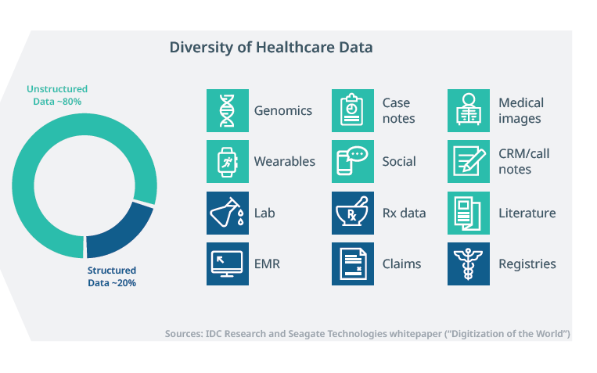
Growth of healthcare data provides a wealth of information, of which unstructured data counts for dominant share up to 80%.
Unstructured data 80%
CAGR (2018-2025)
Healthcare 40%
Non-healthcare 20%
Global demand for data storage ~33,000 Zettabytes*, of which healthcare data is 8%
Notes:
EMR, clinical report
paper, literature, post, conference, talking
official files, patient voice, physican vioce, competitor voice

Slide 4

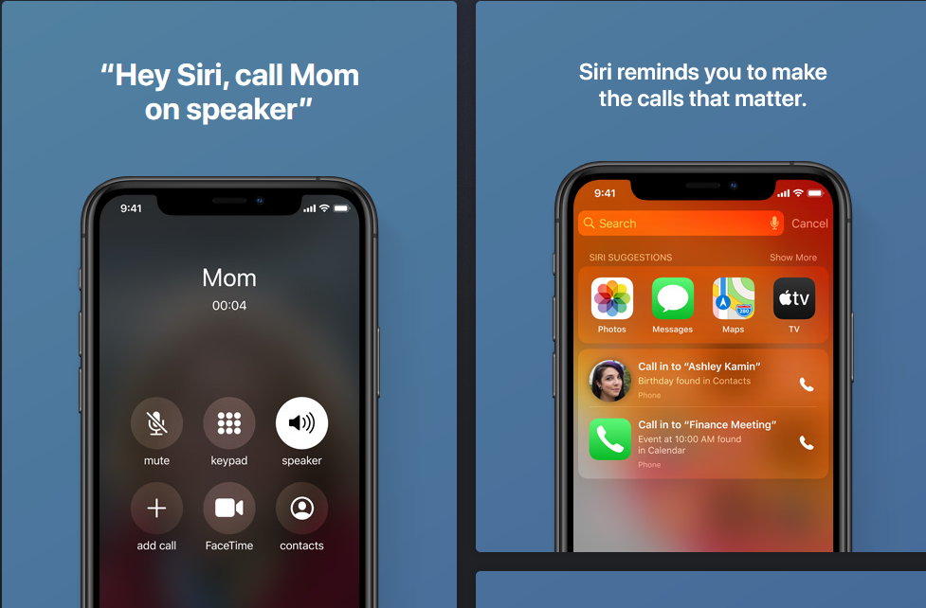
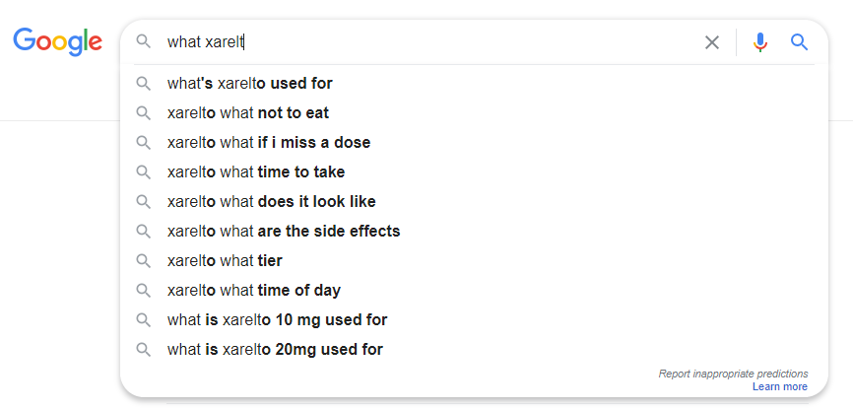
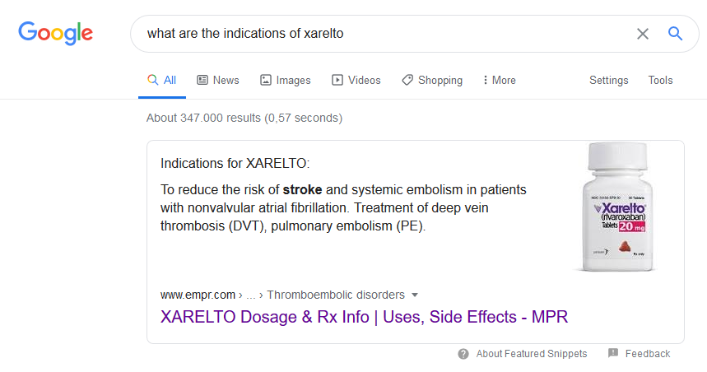



AI related advanced analytics accelerate business digitalization, with unparalleled computing power, rich data and advanced algorithm
Sentiment analysis
Text classification
Text extraction
Natural language processing (NLP) refers to the branch of computer science—and more specifically, the branch of artificial intelligence or AI—concerned with giving computers the ability to understand text and spoken words in much the same way human beings can.
Chatbot and virtual assistant
Speech Recognition
Machine translation
Intent identification
Auto-correct
Customer voice and Market intelligence
Notes:
1. Sentiment Analysis
Natural language understanding is particularly difficult for machines when it comes to opinions, given that humans often use sarcasm and irony. Sentiment analysis, however, is able to recognize subtle nuances in emotions and opinions ‒ and determine how positive or negative they are.
When you analyze sentiment in real-time, you can monitor mentions on social media (and handle negative comments before they escalate), gauge customer reactions to your latest marketing campaign or product launch, and get an overall sense of how customers feel about your company.
You can also perform sentiment analysis periodically, and understand what customers like and dislike about specific aspects of your business ‒ maybe they love your new feature, but are disappointed about your customer service. Those insights can help you make smarter decisions, as they show you exactly what things to improve.
Try out this online sentiment analyzer to see how natural language processing sorts your text by emotions:
Test with your own text
Results
TagConfidence
Positive87.9%
2. Text Classification
Text classification, a text analysis task that also includes sentiment analysis, involves automatically understanding, processing, and categorizing unstructured text.
Let’s say you want to analyze hundreds of open-ended responses to your recent NPS survey. Doing it manually would take you a lot of time and end up being too expensive. But what if you could train a natural language processing model to automatically tag your data in just seconds, using predefined categories and applying your own criteria?
You might use a topic classifier for NPS survey responses, which automatically tags your data by topics like Customer Support, Features, Ease of Use, and Pricing. Give it a try and see how it performs!
3. Chatbots & Virtual Assistants
Chatbots and virtual assistants are used for automatic question answering, designed to understand natural language and deliver an appropriate response through natural language generation.
Standard question answering systems follow pre-defined rules, while AI-powered chatbots and virtual assistants are able to learn from every interaction and understand how they should respond. The best part: they learn from interactions and improve over time.
These intelligent machines are increasingly present at the frontline of customer support, as they can help teams solve up to 80% of all routine queries and route more complex issues to human agents. Available 24/7, chatbots and virtual assistants can speed up response times, and relieve agents from repetitive and time-consuming queries.
4. Text Extraction
Text extraction, or information extraction, automatically detects specific information in a text, such as names, companies, places, and more. This is also known as named entity recognition. You can also extract keywords within a text, as well as pre-defined features such as product serial numbers and models.
Applications of text extraction include sifting through incoming support tickets and identifying specific data, like company names, order numbers, and email addresses without needing to open and read every ticket.
You might also want to use text extraction for data entry. You could pull out the information you need and set up a trigger to automatically enter this information in your database.
Keyword extraction, on the other hand, gives you an overview of the content of a text, as this free natural language processing model shows. Combined with sentiment analysis, keyword extraction can add an extra layer of insight, by telling you which words customers used most often to express negativity toward your product or service.
Try out this online keyword extractor:
Test with your own text
Results
TagValue
KEYWORDelon musk
KEYWORDsecond image
KEYWORDspacesuit
KEYWORDbody look
KEYWORDnew design
KEYWORDphoto
KEYWORDspacex
5. Machine Translation
Machine translation (MT) is one of the first applications of natural language processing. Even though Facebooks’s translations have been declared superhuman, machine translation still faces the challenge of understanding context.
However, if you’ve been an avid user of Google Translate over the years, you’ll know that it has come a long way since its inception, mainly thanks to huge advances in the field of neural networks and the increased availability of large amounts of data.
Automated translation is particularly useful in business because it facilitates communication, allows companies to reach broader audiences, and understand foreign documentation in a fast and cost-effective way.
6. Text Summarization
Automatic summarization is pretty self-explanatory. It summarizes text, by extracting the most important information. Its main goal is to simplify the process of going through vast amounts of data, such as scientific papers, news content, or legal documentation.
There are two ways of using natural language processing to summarize data: extraction-based summarization ‒ which extracts keyphrases and creates a summary, without adding any extra information ‒ and abstraction-based summarization, which creates new phrases paraphrasing the original source. This second approach is more common and performs better.
7. Market Intelligence
Marketers can benefit from natural language processing to learn more about their customers and use those insights to create more effective strategies.
Analyzing topics, sentiment, keywords, and intent in unstructured data can really boost your market research, shedding light on trends and business opportunities. You can also analyze data to identify customer pain points and to keep an eye on your competitors (by seeing what things are working well for them and which are not).
8. Auto-Correct
Natural Language Processing plays a vital role in grammar checking software and auto-correct functions. Tools like Grammarly, for example, use NLP to help you improve your writing, by detecting grammar, spelling, or sentence structure errors.
9. Intent Classification
Intent classification consists of identifying the goal or purpose that underlies a text. Apart from chatbots, intent detection can drive benefits in sales and customer support areas.
By analyzing customer interactions like emails, chats, or social media posts, you can spot customers that are ready to purchase. The faster you can detect and classify those leads, the more chances you have of turning them into customers. Try this email classifier, and sort responses into categories like Interested, Not Interested, and Unsubscribe.
Finally, looking for customer intent in customer support tickets or social media posts can warn you of customers at risk of churn, allowing you to take action with a strategy to win them back.
10. Urgency Detection
NLP techniques can also help you detect urgency in text. You can train an urgency detection model using your own criteria, so it can recognize certain words and expressions that denote gravity or discontent. This can help you prioritize the most important requests and make sure they don’t get buried under a pile of unresolved tickets.
Urgency detection helps you improve response times and efficiency, leading to a positive impact on customer satisfaction.
11. Speech Recognition
Speech recognition technology uses natural language processing to transform spoken language into a machine-readable format.
Speech recognition systems are an essential part of virtual assistants, like Siri, Alexa, and Google Assistant, for example. However, there are more and more use cases of speech recognition in business. For example, adding speech-to-text capabilities to business software, companies are able to automatically transcribe calls, send emails, and even translate.
Discover Natural Language Processing Tools
Natural language processing has many exciting applications.
Natural language processing tools help businesses process huge amounts of unstructured data, like customer support tickets, social media posts, survey responses, and more.
Not only are they used to gain insights to support decision-making, but also to automate time-consuming tasks.
SaaS tools are the most accessible way to get started with natural language processing. With an AI-platform like MonkeyLearn, you can start using pre-trained models right away, or build a customized NLP solution in just a few steps (no coding needed).

Slide 5

The efficiency gains do not mean only person days saved, but also more business insights and values generated
Consider 2 scenarios
The hypothesis is more time on proactive thinking, more productive in business
When you are working with excel pivot table, but it responses very slowly, how is your analysis going?
When you would like to do a meta analysis, and need to extract key columns from 100+ literatures, how is your feeling?
^{Efficiency}
^{Insights}
^{Revenue}
save person days and corresponding cost in operations, and focus on strategic matters
More hints for your business strategies
More productivity, more agility and more business values
Notes:
Efficiency gains
Decision making
More time on deeper analysis with human intelligence…
Intelligent Interaction
Efficiency gains -> digital tools
Decision making
More agile
More direction to try
Less chances to fail
Less cost with failure
More time on deeper analysis with human intelligence…
Intelligent Interaction
Consider a case
When excel response very slowly, no consistent thinking could be continued (structured, so unstructured? )
Meta analysis

Slide 6
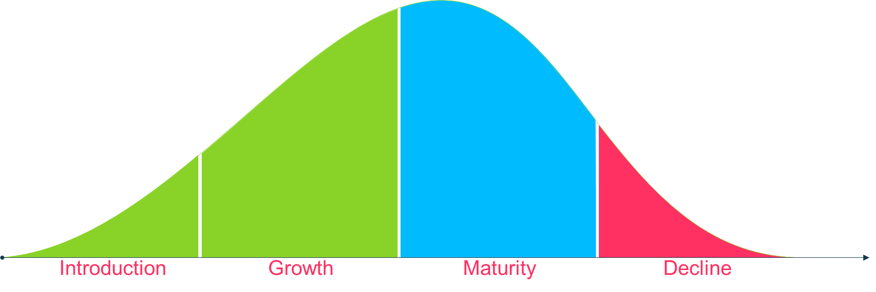



NLP has been widely applied across the whole value chains in full life cycle of drugs.
Not exhausted
Drug Discovery
Trial Development
Regulatory
Precision medicine
Understanding gene-disease associations, pathways and systems, is critical for drug discovery and basic research. Much of the data to support these decisions are buried in unstructured text, both in public databases and internal sources, and it’s a constant challenge to keep on top of this information
Extracting and synthesizing the high value information that is found in this unstructured text. This can then be used in future study design and site selection, or to gain actionable information about competitors' worldwide clinical development activities.
to find, highlight, and extract key data within regulatory documents, check for MedDRA coding, mark up inconsistencies across documents, and more.
Drug safety and PV
ROI of 3.3 to 1 in operating income for involved TAs, and dramatic increase in penetration rates and associated revenues (>40% YoY in one TA) from commercial digital transformation
Patent analytics
Voice of Customer
Real world data analytics
Marketing contents optimization
to understand how their therapeutics are being used by patients and understand a broader picture of patient reported outcomes. Are patients struggling with the packaging, with the formulation? Are there unexpected safety signals? Are patients switching? What competitor products are being mentioned? What are the trends from key opinion leaders or healthcare professionals?
in recent years, the use of computers, mobile devices, wearables and other biosensors to gather and store health-related data, both structured and unstructured, has grown rapidly. Combined with analytical capabilities such as NLP, this data has the potential to improve the way patients are treated, clinical trials are conducted, drugs are developed, and, in doing so, provide answers to questions previously thought beyond reach.
Health technology assessment
…
Notes:
Roche - Patient Insights from Social Media
Discover if patient blogs and forum can provide a good substrate to develop clinical endpoints that are relevant to patients. Being able to understand what matters most to patients and find unexpected insights into patients’ problems could (and should) influence clinical trials
J&J - NLP analytics for regulatory compliance and IDMP master data management
Extract ~30 standard IDMP data elements from regulatory documents including Summary of Product Characteristics and regulatory dossiers
Cambridge University Hospital
Identify Surgical Site Infections (SSI) using Mixed Assessment of Free Text and Structured Data in Electronic Health Records

Slide 7
How NLP works

Slide 8



Make computer to understand text step by step
目的 评价地诺孕素（DNG）对于难治性子宫内膜异位症（内异症）疼痛的临床疗效和安全性。
方法 本研究将难治性内异症疼痛定义为：（1）内异症相关疼痛时间≥12个月，疼痛视觉模拟评分（VAS）≥60 mm；（2）既往经口服避孕药、左炔诺孕酮宫内缓释系统等2种以上药物治疗效果不满意，VAS评分降幅<50%；或应用促性腺激素释放激素激动剂、米非司酮等可控制疼痛，但停药后疼痛再次发生；（3）疼痛经手术或反复手术后，仍不能控制。本研究对2016年11月至2020年2月48例符合标准的难治性内异症疼痛患者口服DNG（2 mg/d）的治疗情况进行回顾性分析，比较用药前后VAS评分、CA₁₂₅水平、雌二醇、FSH、LH、内异症病灶大小的变化，并记录副作用。
结果 DNG用药时间为（20.1±12.8）个月。用药3个月时VAS评分由基线的（77.9±15.8） mm显著降低至（20.8±10.7） mm（P<0.01），CA₁₂₅水平由基线的（95±139） kU/L显著降低至（38±45） kU/L （P<0.05）。随着用药时间延长，疼痛缓解的治疗效果继续维持，CA₁₂₅继续维持在低水平。卵巢子宫内膜异位囊肿经用药12个月后囊肿最大径线由（3.1±1.0） cm显著缩小至（1.9±1.2） cm（P<0.05）。用药期间雌二醇平均水平维持在124.82~221.04 pmol/L，FSH、LH水平无明显变化。主要副作用是不规则出血（75%，36/48）。
结论 DNG能有效缓解内异症疼痛，且耐受性好，可作为复杂的难治性内异症疼痛患者长期治疗的选择之一。
Sentence splitting
Word tokenization
NLP
Remove meaningless
words
text 》numbers
Semantic representation
Source::徐冰, 李华军, 贾婉璐, 等. 地诺孕素用于难治性子宫内膜异位症疼痛的临床研究 [J] . 中华妇产科杂志, 2021, 56(3) : 178-184. DOI: 10.3760/cma.j.cn112141-20200525-00444.
Notes:
加动画，说一下需要人工的输入，今天简化来看一下

Slide 9
Sentence splitting: from document to sentence
text 》numbers
1
目的 评价地诺孕素（DNG）对于难治性子宫内膜异位症（内异症）疼痛的临床疗效和安全性。
方法 本研究将难治性内异症疼痛定义为：（1）内异症相关疼痛时间≥12个月，疼痛视觉模拟评分（VAS）≥60 mm；（2）既往经口服避孕药、左炔诺孕酮宫内缓释系统等2种以上药物治疗效果不满意，VAS评分降幅<50%；或应用促性腺激素释放激素激动剂、米非司酮等可控制疼痛，但停药后疼痛再次发生；（3）疼痛经手术或反复手术后，仍不能控制。本研究对2016年11月至2020年2月48例符合标准的难治性内异症疼痛患者口服DNG（2 mg/d）的治疗情况进行回顾性分析，比较用药前后VAS评分、CA₁₂₅水平、雌二醇、FSH、LH、内异症病灶大小的变化，并记录副作用。
结果 DNG用药时间为（20.1±12.8）个月。用药3个月时VAS评分由基线的（77.9±15.8） mm显著降低至（20.8±10.7） mm（P<0.01），CA₁₂₅水平由基线的（95±139） kU/L显著降低至（38±45） kU/L （P<0.05）。随着用药时间延长，疼痛缓解的治疗效果继续维持，CA₁₂₅继续维持在低水平。卵巢子宫内膜异位囊肿经用药12个月后囊肿最大径线由（3.1±1.0） cm显著缩小至（1.9±1.2） cm（P<0.05）。用药期间雌二醇平均水平维持在124.82~221.04 pmol/L，FSH、LH水平无明显变化。主要副作用是不规则出血（75%，36/48）。
结论 DNG能有效缓解内异症疼痛，且耐受性好，可作为复杂的难治性内异症疼痛患者长期治疗的选择之一。
目的 评价地诺孕素（DNG）对于难治性子宫内膜异位症（内异症）疼痛的临床疗效和安全性
方法 本研究将难治性内异症疼痛定义为：（1）内异症相关疼痛时间≥12个月，疼痛视觉模拟评分（VAS）≥60 mm；（2）既往经口服避孕药、左炔诺孕酮宫内缓释系统等2种以上药物治疗效果不满意，VAS评分降幅<50%；或应用促性腺激素释放激素激动剂、米非司酮等可控制疼痛，但停药后疼痛再次发生；（3）疼痛经手术或反复手术后，仍不能控制
本研究对2016年11月至2020年2月48例符合标准的难治性内异症疼痛患者口服DNG（2 mg/d）的治疗情况进行回顾性分析，比较用药前后VAS评分、CA125水平、雌二醇、FSH、LH、内异症病灶大小的变化，并记录副作用'
结果 DNG用药时间为（20.1±12.8）个月’,
用药3个月时VAS评分由基线的（77.9±15.8） mm显著降低至（20.8±10.7） mm（P<0.01），CA125水平由基线的（95±139） kU/L显著降低至（38±45） kU/L （P<0.05）
随着用药时间延长，疼痛缓解的治疗效果继续维持，CA125继续维持在低水平
卵巢子宫内膜异位囊肿经 用药12个月后囊肿最大径线由（3.1±1.0） cm显著缩小至（1.9±1.2） cm（P<0.05）
用药期间雌二醇平均水平维持在124.82~221.04 pmol/L，FSH、LH水平无明显变化
主要副作用是不规则出血（75%，36/48）
结论 DNG能有效缓解内异症疼痛，且耐受性好，可作为复杂的难治性内异症疼痛患者长期治疗的选择之一

Slide 10
Word tokenization: from sentence to words
text 》numbers
1
2
目的
评价
地诺孕素
（
DNG
）
对于
难治性
子宫内膜异位症
（
内异症
）
疼痛
的
临床
疗效
和
安全性
目的 评价地诺孕素（DNG）对于难治性子宫内膜异位症（内异症）疼痛的临床疗效和安全性

Slide 11
Remove meaningless words including punctuations, numbers, stop words
text 》numbers
1
2
3
Stop words can be customized according to specific domain and specific task.
目的
评价
地诺孕素
（
DNG
）
对于
难治性
子宫内膜异位症
（
内异症
）
疼痛
的
临床
疗效
和
安全性
目的
评价
地诺孕素
DNG
难治性
子宫内膜异位症
内异症
疼痛
临床
疗效
安全性
目的 评价地诺孕素（DNG）对于难治性子宫内膜异位症（内异症）疼痛的临床疗效和安全性

Slide 12

Semantic representation: transfer text into numbers
text 》numbers
1
2
3
4
目的
评价
地诺孕素
DNG
难治性
子宫内膜异位症
内异症
疼痛
临床
疗效
安全性
Text
NLP
Traditional method one-hot
Numbers
NLP
Advanced method language model

Slide 13

Step 4-Traditional semantic representation: One-Hot
text 》numbers
4
目的 [1,0, …………………………………….,0] n-dimensional
评价 [0,1, ………………………………….…,0] n-dimensional
地诺孕素 [0,0,1,………………………………..…,0] n-dimensional
DNG [0,0,0,1,0,………………………………,0] n-dimensional
难治性 [0,0,0,0,1,0,……………………………,0] n-dimensional
子宫内膜异位症[0,0,0,0,0,1,0,………………………,0] n-dimensional
内异症 [0,0,0,0,0,0,1,0,…………………….…,0] n-dimensional
疼痛 [0,0,0,0,0,0,0,1,0,……………………..,0] n-dimensional
临床 [0,0,0,0,0,0,0,0,1,0,…………………..,0] n-dimensional
疗效 [0,0,0,0,0,0,0,0,0,1,0,…………….…..,0] n-dimensional
安全性 [0,0,0,0,0,0,0,0,0,0,1,0,…………..…..,0] n-dimensional
方法 [0,0,0,0,0,0,0,0,0,0,0,1,0,………….…,0] n-dimensional
本研究 [0,0,0,0,0,0,0,0,0,0,0,0,1,0,… …..…,0] n-dimensional
将 [0,0,0,0,0,0,0,0,0,0,0,0,0,1,0,… …..,0] n-dimensional
难治性 [0,0,0,0,0,0,0,0,0,0,0,0,0,0,1,0,… …,0] n-dimensional
定义 [0,0,0,0,0,0,0,0,0,0,0,0,0,0,0,1,0, …,0] n-dimensional
相关 [0,0,0,0,0,0,0,0,0,0,0,0,0,0,0,0,1,0,…,0] n-dimensional
时间 [0,0,0,0,0,0,0,0,0,0,0,0,0,0,0,0,0,1,…,0] n-dimensional
… … … …
i word_{i} [0₁,0₂,………….,0_{i-1},1,0_{i+1},…………..,0_{n}] n-dimensional
… … … …
N word_{n} [0₁,0₂,………………………………,0_{n-1},1] n-dimensional
1: Generate dictionary
2: Transfer sentence into vectors
目的
评价
地诺孕素
DNG
难治性
子宫内膜异位症
内异症
疼痛
临床
疗效
安全性
[1,1,1,1,1,1,1,1,1,1,1,0,…,0_{th}]
Sentence_{i} = [v_{i1},v_{i2},v_{i3},…,v_{ij,…,}v_{in}]
N is the number of non-repetitive words in the corpus
,Where v_{ij} = the number of the specific word in the current sentence

Slide 14
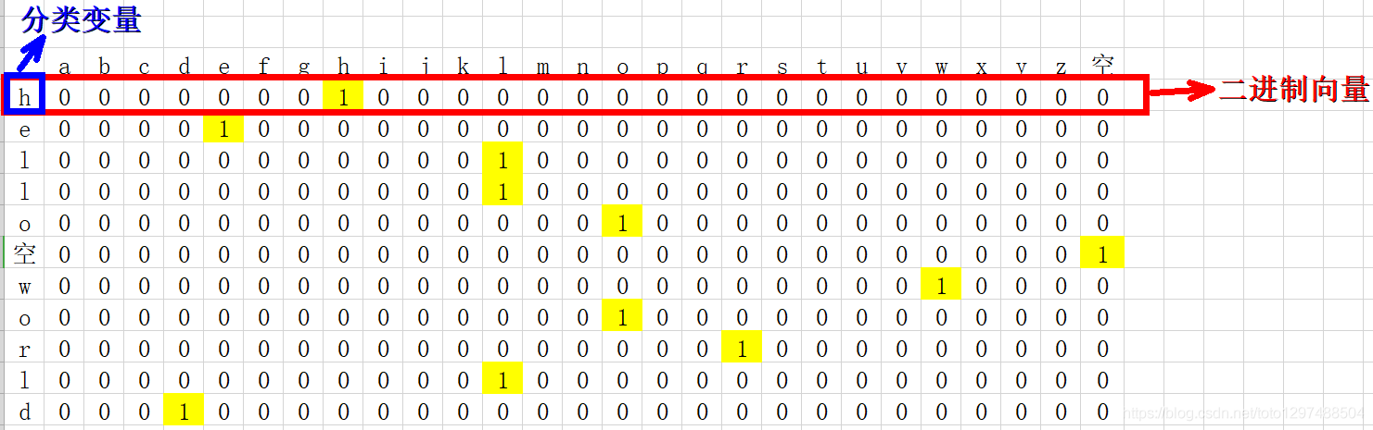
Step 4-Weakness of traditional text representation
text 》numbers
4
Waste space
Ignore semantics
Reason 1
Different semantics
Sentence₁ = ‘’
Sentence₂ = ‘Kerendia is approved for slowing the progression of CKD in T2D’
Different semantics
Assume there are 1,000,000 non-repetitive words in the dictionary
For a sentence vector, most of the value in the vector is 0
Space waste
Finerenone
Kerendia
Two words are far away from each other in semantic space
1,000,000 dimensions

Slide 15
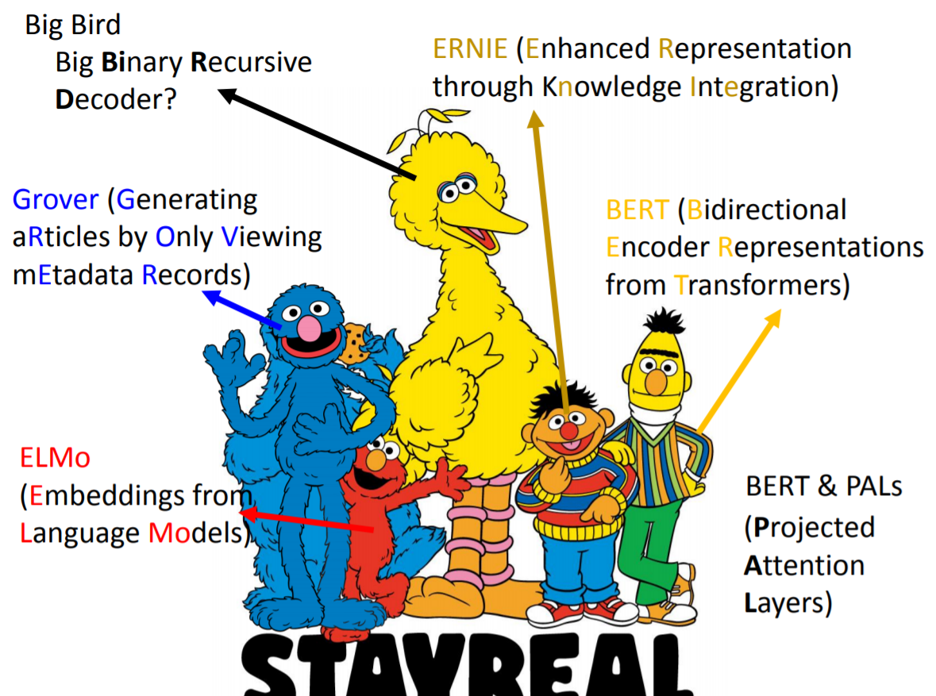
Step 4-Advanced text representation: Language Model
text 》numbers
4
Bert: train computer to do two tasks
^{Language model}
A general name of neutral network-based models which is used to help computer understand semantics automatically
Task 1: Cloze Test
Task 2: Next Sentence Prediction
小明喜欢吃肯德基的_______。
汉堡----------------30%
唯散宁-------------0.1%
小茗服用_______来治疗内异症。
汉堡----------------0.1%
唯散宁-------------30%
小茗有子宫内膜异位症怎么办？___Next?_____
拜耳的唯散宁效果不错。
Yes----------------70%
No-----------------30%
肯德基的汉堡挺好吃。
Yes----------------30%
No-----------------70%

Slide 16
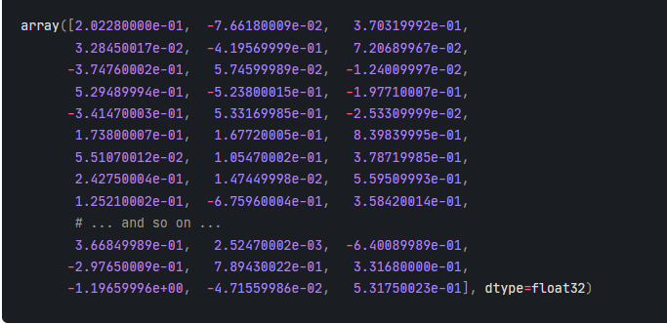
Language model – Bert: Better text representation
text 》numbers
4
Less space
More accurate semantics
Finerenone
Kerendia
1,000,000 dimensions
Kerendia
Finerenone
100~300 dimensions
Notes:
计算机得到知识 我们再去审查，查看计算机获得的知识

Slide 17
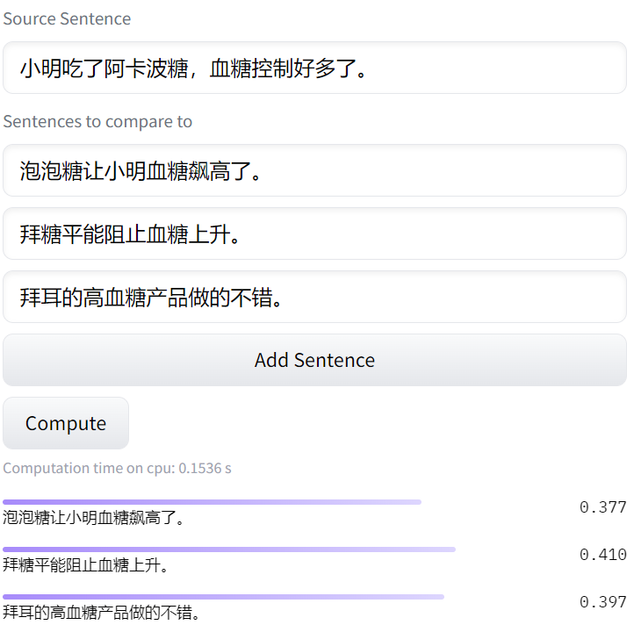
NLP is not character matching, but semantic understanding
text 》numbers
4
Source: symanto/sn-xlm-roberta-base-snli-mnli-anli-xnli · Hugging Face
Notes:
写错字了，加快了计算机的进程

Slide 18

NLP aims at Decision Supporting not Decision Making!
1
Components illustration
Maturity
Complexity
Natural language extraction
Name entity extraction
Relation extraction
Low
^{Put Humans}
^{into NLP Loop}
2
Natural language understanding
Sentiment analysis
Chatbot and virtual assistant
Voice of customers
Machine translation ...
Medium
^{Case: TL insights exploration}
3
^{Computer Result}
^{-Patient related term:}
^{年龄：高龄、儿童}
Natural language generation
^{big data}
Abstract and summarization
Contents generation
High
^{Expert Knowledge}
^{-Patient related aspect: 年龄}
Source: https://chinesenlp.xyz/#/

Slide 19
NLP @ Bayer

Slide 20
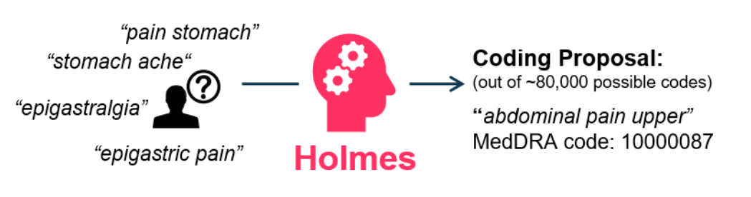
Holmes # Efficiency gains @R&D#
Case 1 | Case 2 | Case 3 | Case 4
Resource: go/holmes
Project background
Technical solution
What is medical coding?
Medical Coding is the process of translating textual descriptions of medical events from e.g., clinical studies into standardized terms and codes. Examples of medical events are healthcare diagnosis, procedures, or medical services.
Medical Coding is an essential pre-requisite for reliable data retrieval and reporting to ensure that the right conclusions can be drawn from clinical studies.
MedDRA is a rich and highly specific standardized medical terminology developed by ICH to facilitate sharing of regulatory information internationally for medical products used by humans
Reported term
Pain point?
Business value
Every month, around 55,000 terms need to be manually coded in our coding department at Bayer by highly specialized medical coders.
Replacing IBM Watson
Saving 530k€/year in licence costs
Outperforming IBM Watson, reaching a 92% accuracy (vs 75% accuracy of IBM Watson)

Slide 21
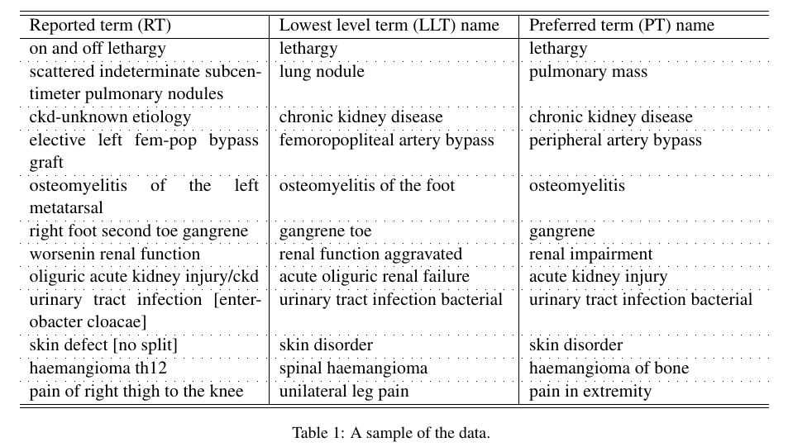
Holmes # Efficiency gains @R&D#
Case 1 | Case 2 | Case 3 | Case 4
MedDRA
Use case

Slide 22
DiMi # Insights generation @Medical#
Case 1 | Case 2 | Case 3 | Case 4
Resource: go/dimi
Project background
Technical solution
What is medical inquiry?
Machine translation
Medical inquiry is unsolicited questions from HCPs, patients and other types of customers related to both Bayer Pharmaceutical and Consumer Health products.
It includes Data vs. Competitor Product, Product Quality Inquiries & PTCs, Inquiries from Patients & Caregivers, Clinical Data Requests, Product Availability, Safety Inquiries & AEs, and Inquiries from HCPs.
Transparency across countries; Enhanced collaboration; Increase in operational efficiency
Topic discovery
Launch Preparation;
Potential to investigate a new indication;
Identify gaps in educational/patient material development
Advanced search engine
Increase in operational efficiency & response timelines for customers; Quick identification of questions of interest
Pain point?
Business value
300,000+ Pharma and Consumer Health inquiries documented worldwide each year
Required manual review of data via Excel in the past to analyze trends
Making better business decisions
Anticipating market events
Informing standard response strategy
Creating benefits for healthcare community

Slide 23
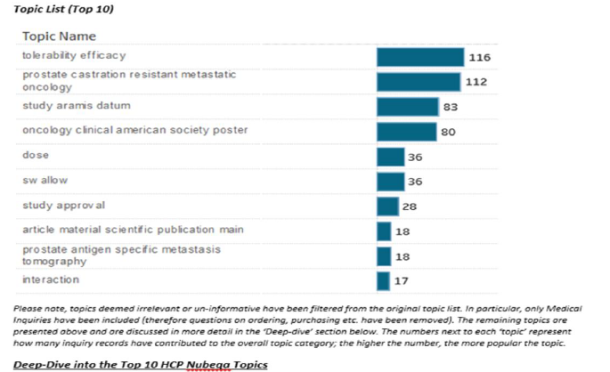
DiMi # Insights generation @Medical#
Case 1 | Case 2 | Case 3 | Case 4
Use case
Cardiorenal
Oncology
Vericiguat/Finerenone/Xarelto
Nubeqa
Assessment of inquiries for Commercial (number; type; indications; channel; customer type etc)
Identifying hot topics and gaps to support prep of educational and marketing materials
Finerenone/Vericiguat continually observed to identify topic trends and to accompany launches
Inquiry trend and topic discovery data across whole portfolio to identify gaps in SRD strategy. Has led to:
Creation of new SRDs e.g. "Nubeqa and crushing/splitting/NG tube administration"
Nubeqa–crushing queries => rationale for potential study
Xarelto
Assessments for MA TA & PV supporting
Preparation of internal and external educational Materials
Possible labelling update
Preparation of a reactive statement on a recent publication (use during pregnancy)

Slide 24
Hermione enables better decision making through faster retrieval of relevant medical evidence
Case 1 | Case 2 | Case 3 | Case 4
Project overview
Business benefits
…Challenge
…efficiency gains and insight generation
The unstructured form of pharma scientific literature and its exponential growth significantly
Currently our TA experts spend up to 30-50% their time in low value-add tasks, like search, selection and review of papers not directly relevant and cannot easily search internal observational study reports
Hermione increases the speed and effectiveness of decision-making for our TA experts by:
leveraging existing infrastructure (e.g. Hubble) and offering additional medical search criteria not available on standard search platforms (Google Scholar, Microsoft Academic, Pubmed, etc.) to retrieve quickly a limited amount of relevant biomedical scientific literature
extending the breadth of research simultaneously to internal data sources (observational study reports @ShareDoc)
…examples
What is the incidence of <disease X> in <population>?
What's prevalence of <disease X> in <population> // by geography, gender, age?”
What study did we conduct on <indication>?
What are symptoms of <disease x>?
Is <drug X> more effective than <drug X> on <population>?
Is <disease x> rare?
Don’t make me search, help me find
Don’t make me read, extract/summarize takeaways for me

Slide 25


Hermione – Use cases
Case 1 | Case 2 | Case 3 | Case 4
Endometriosis
Finerenone
Diabetic retinopathy
(DR):
NonProliferative
Diabetic Retinopathy (NPDR)
Found high quality study not easily accessible before and discovered known measures like incidence
Discovered insights on studies of Finerenone vs. Eplerenone in Japanese Patients
Discovered insights on the natural history of diabetic retinopathy (DR) in diabetic patients that led to the decision to not run a specific time-consuming data analysis
Found results of analysis from Regeneron Pharmaceuticals, Inc on Progression to Proliferative Diabetic Retinopathy in NPDR Eyes without Diabetic Macular Edemain the United States
reduced time from hours/days to minutes/seconds
qualitative knowledge gain, avoid study duplication
saved days repeating already available analysis
qualitative knowledge gain

Slide 26
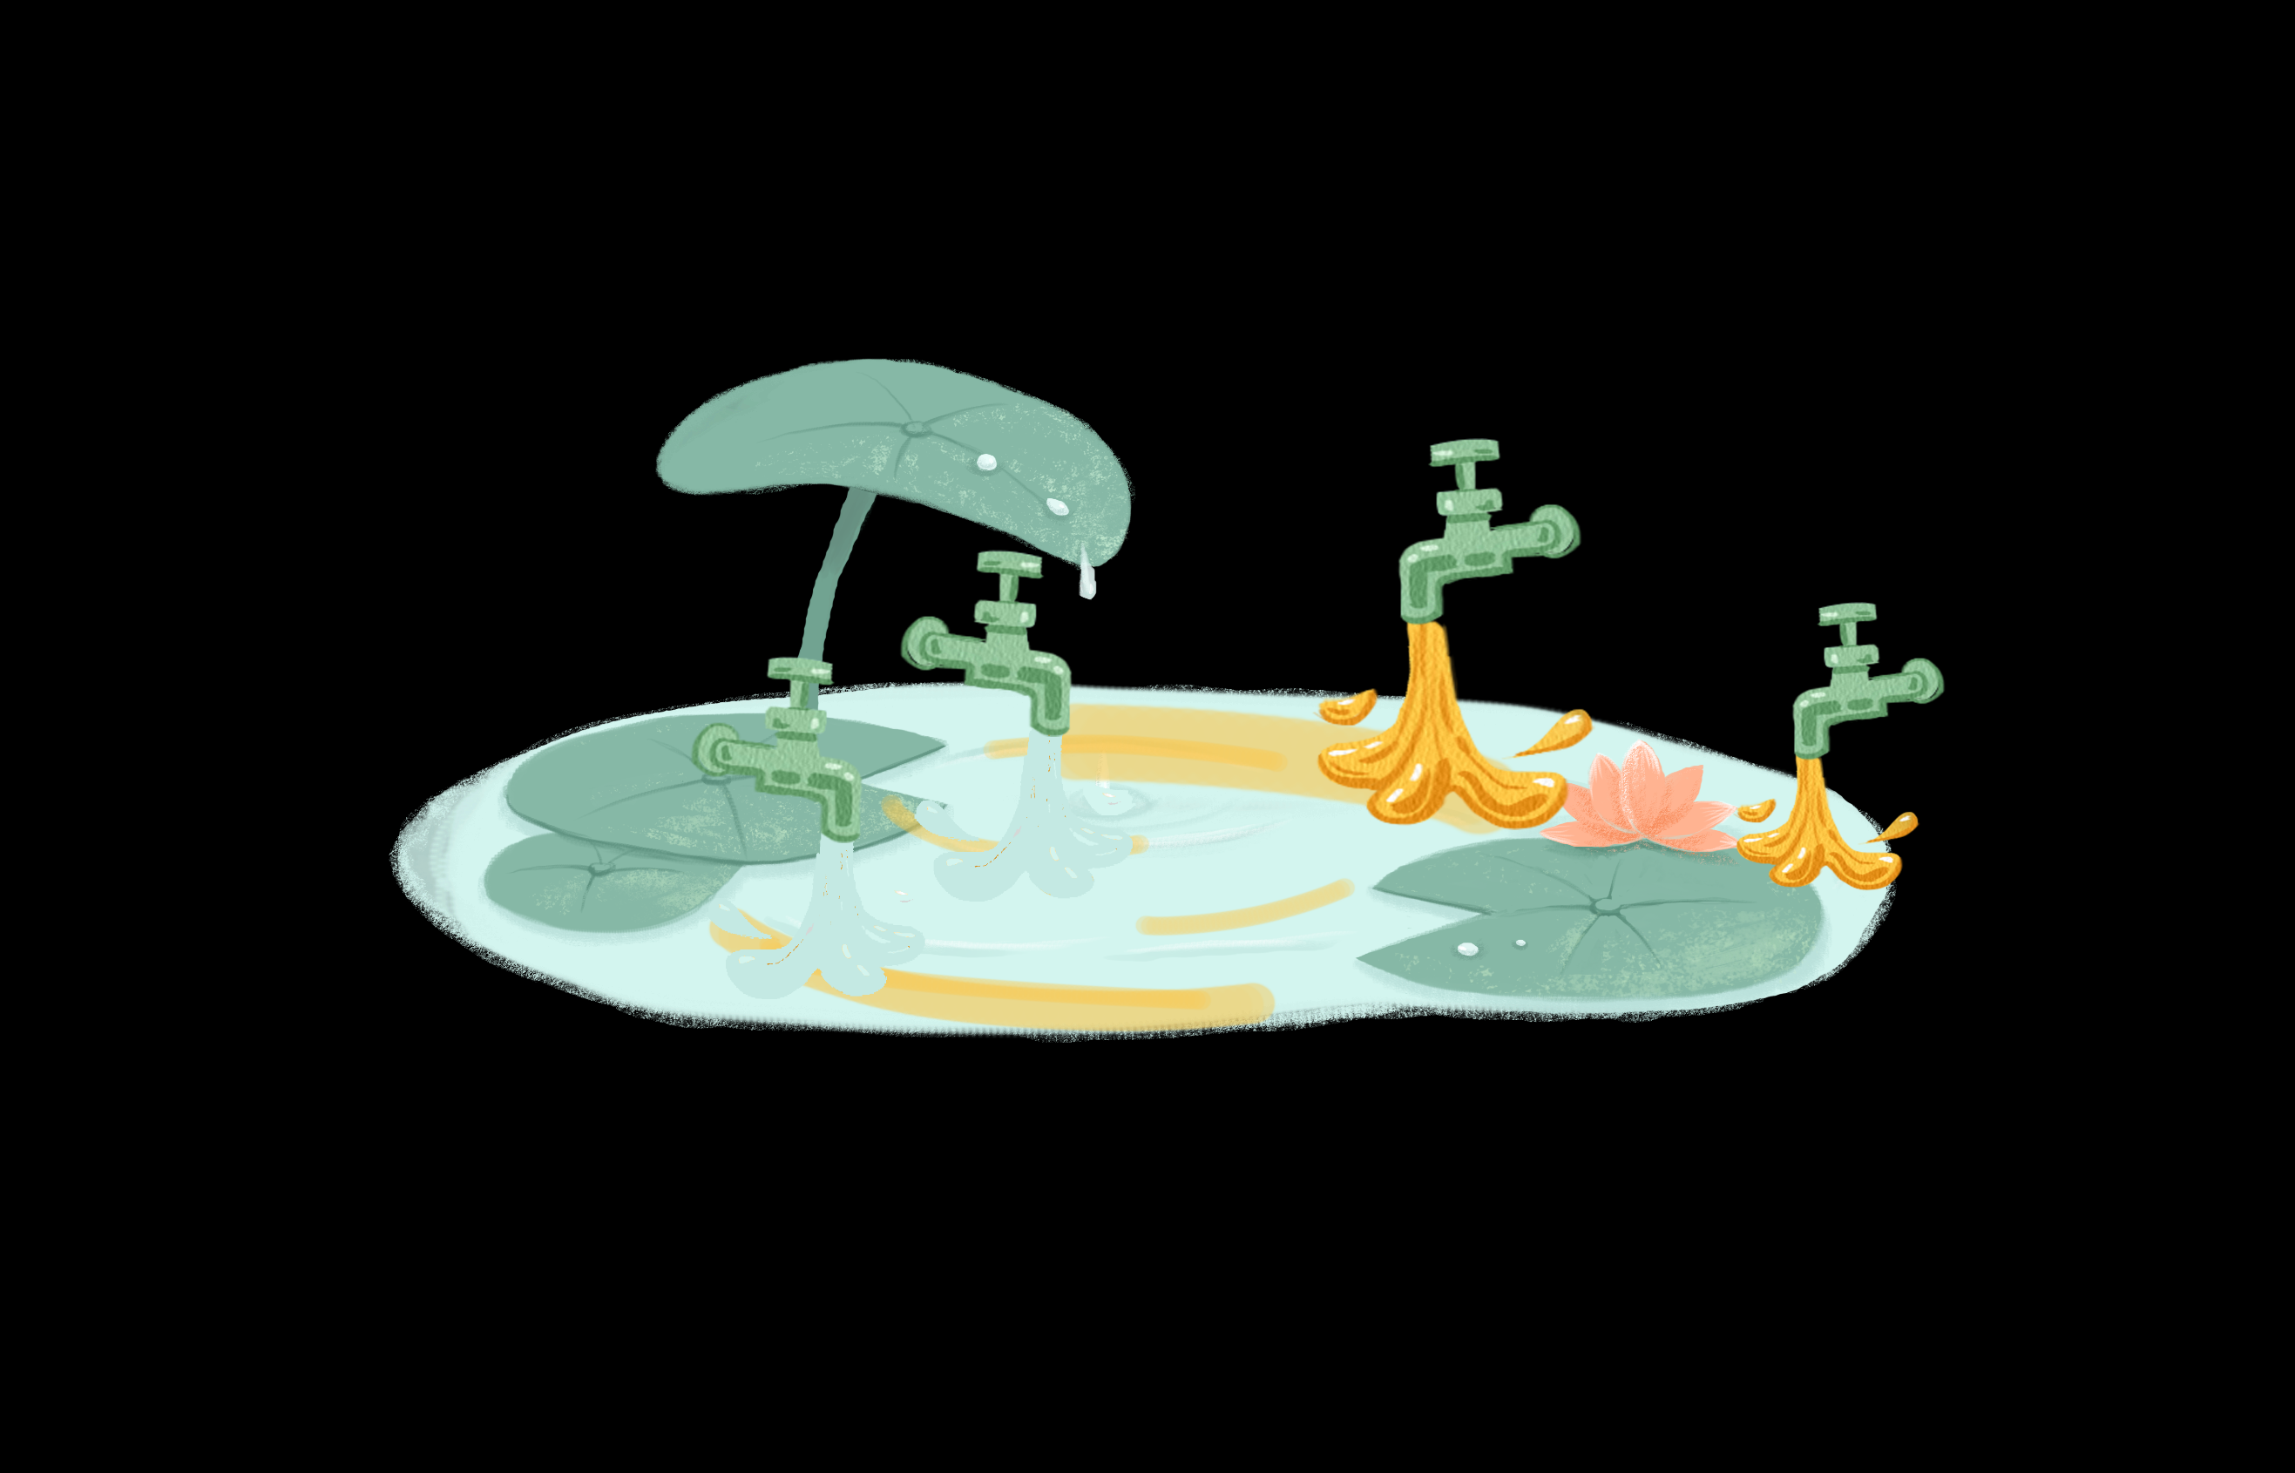
Voice of Customer – from focus group to big data in social listening
Case 1 | Case 2 | Case 3 | Case 4
Project overview
Business benefits
…Challenge
…enabling quick and precise market campaign planning
Living in a world of exploding data in the social media, it is valuable to listen to the healthcare professionals and their voice, reflecting in the literatures, wechat articles, as well as speech in the key conferences.
Despite the potential, how we capture and analyze the data can be challenging. We used to leverage the focus group or interview with thought leaders, however we can’t capture everything, nor can we ask long lists of questions repeatedly to get what we need.
Thus, it is necessary to fully leverage the social media to listen to the voice through the behavior of thought leaders, especially the articles with relatively negative voice towards our Bayer products.
Here NLP could cure…
NLP could quickly analyze all the articles from all the targeting channels, and visualized with targeting labeling,
NLP could quickly locate the article sentiment, that could further
Alert on the +/- ratio 正负声量的预警
Alert on all the negative articles 负面文章预警
The reactions could be quickly managed to influence the brand voice in the market
Influence KOLs and plan on the media delivery planning
论引导：专家KOL引导、媒体投放规划
Crisis planning, e.g. key conference
危机应对 – 医学重点会议
Notes:
Despite the potential, how we capture and analyze the data can be challenging. We can’t capture everything, nor can we ask long lists of questions repeatedly to get what we need. For more observational techniques, concerns around privacy, sample bias and the sheer impracticality of monitoring and capturing data continuously means we must be thoughtful about how we best answer out questions balancing cost, inconvenience and intrusion on one hand with the potential of improved treatment and care on the other
当舆情正负比值到达警戒线时，系统实时发出提醒
每出现一篇新的负面文章时，系统实时发出提醒

Slide 27

Voice of Customer – from focus group to big data in social listening
Case 1 | Case 2 | Case 3 | Case 4
Only positive
行动路线：引导中立KOL转向，加强正向KOL发声引导舆论
Positive + neutral
3
only neutral
1
郭艺芳
2
Positive + neutral + negative
丁荣晶
葛均波
候静波
马长生
冀连梅
2
汪芳
许予明
孔令秋
唐熠达
1
6
Positive + negative
Only negative + neutral
3
许俊堂
李小鹰
刘健
孙艺红
杨进刚
Negative only

Slide 28

Thank you!
Bye-Bye

Slide 29
Hermione enables better decision making through faster retrieval of relevant medical evidence
Project overview
Business benefits
…Challenge
…efficiency gains and insight generation
The unstructured form of pharma scientific literature and its exponential growth significantly
Currently our TA experts spend up to 30-50% their time in low value-add tasks, like search, selection and review of papers not directly relevant and cannot easily search internal observational study reports
Can be repeatedly used and leveraged across org
Easier and easier to mobilise and deliver impact
Improvement of capabilities as experience increases
Focus on delivering high momentum and pace as well as cost effective
…Solution
…examples
Hermione increases the speed and effectiveness of decision-making for our TA experts by:
leveraging existing infrastructure (e.g. Hubble) and offering additional medical search criteria not available on standard search platforms (Google Scholar, Microsoft Academic, Pubmed, etc.) to retrieve quickly a limited amount of relevant biomedical scientific literature
extending the breadth of research simultaneously to internal data sources (observational study reports @ShareDoc)
What is the incidence of <disease X> in <population>?
What's prevalence of <disease X> in <population> // by geography, gender, age?”
What study did we conduct on <indication>?
What are symptoms of <disease x>?
Is <drug X> more effective than <drug X> on <population>?
Is <disease x> rare?
Don’t make me search, help me find
Don’t make me read, extract/summarize takeaways for me

Slide 30
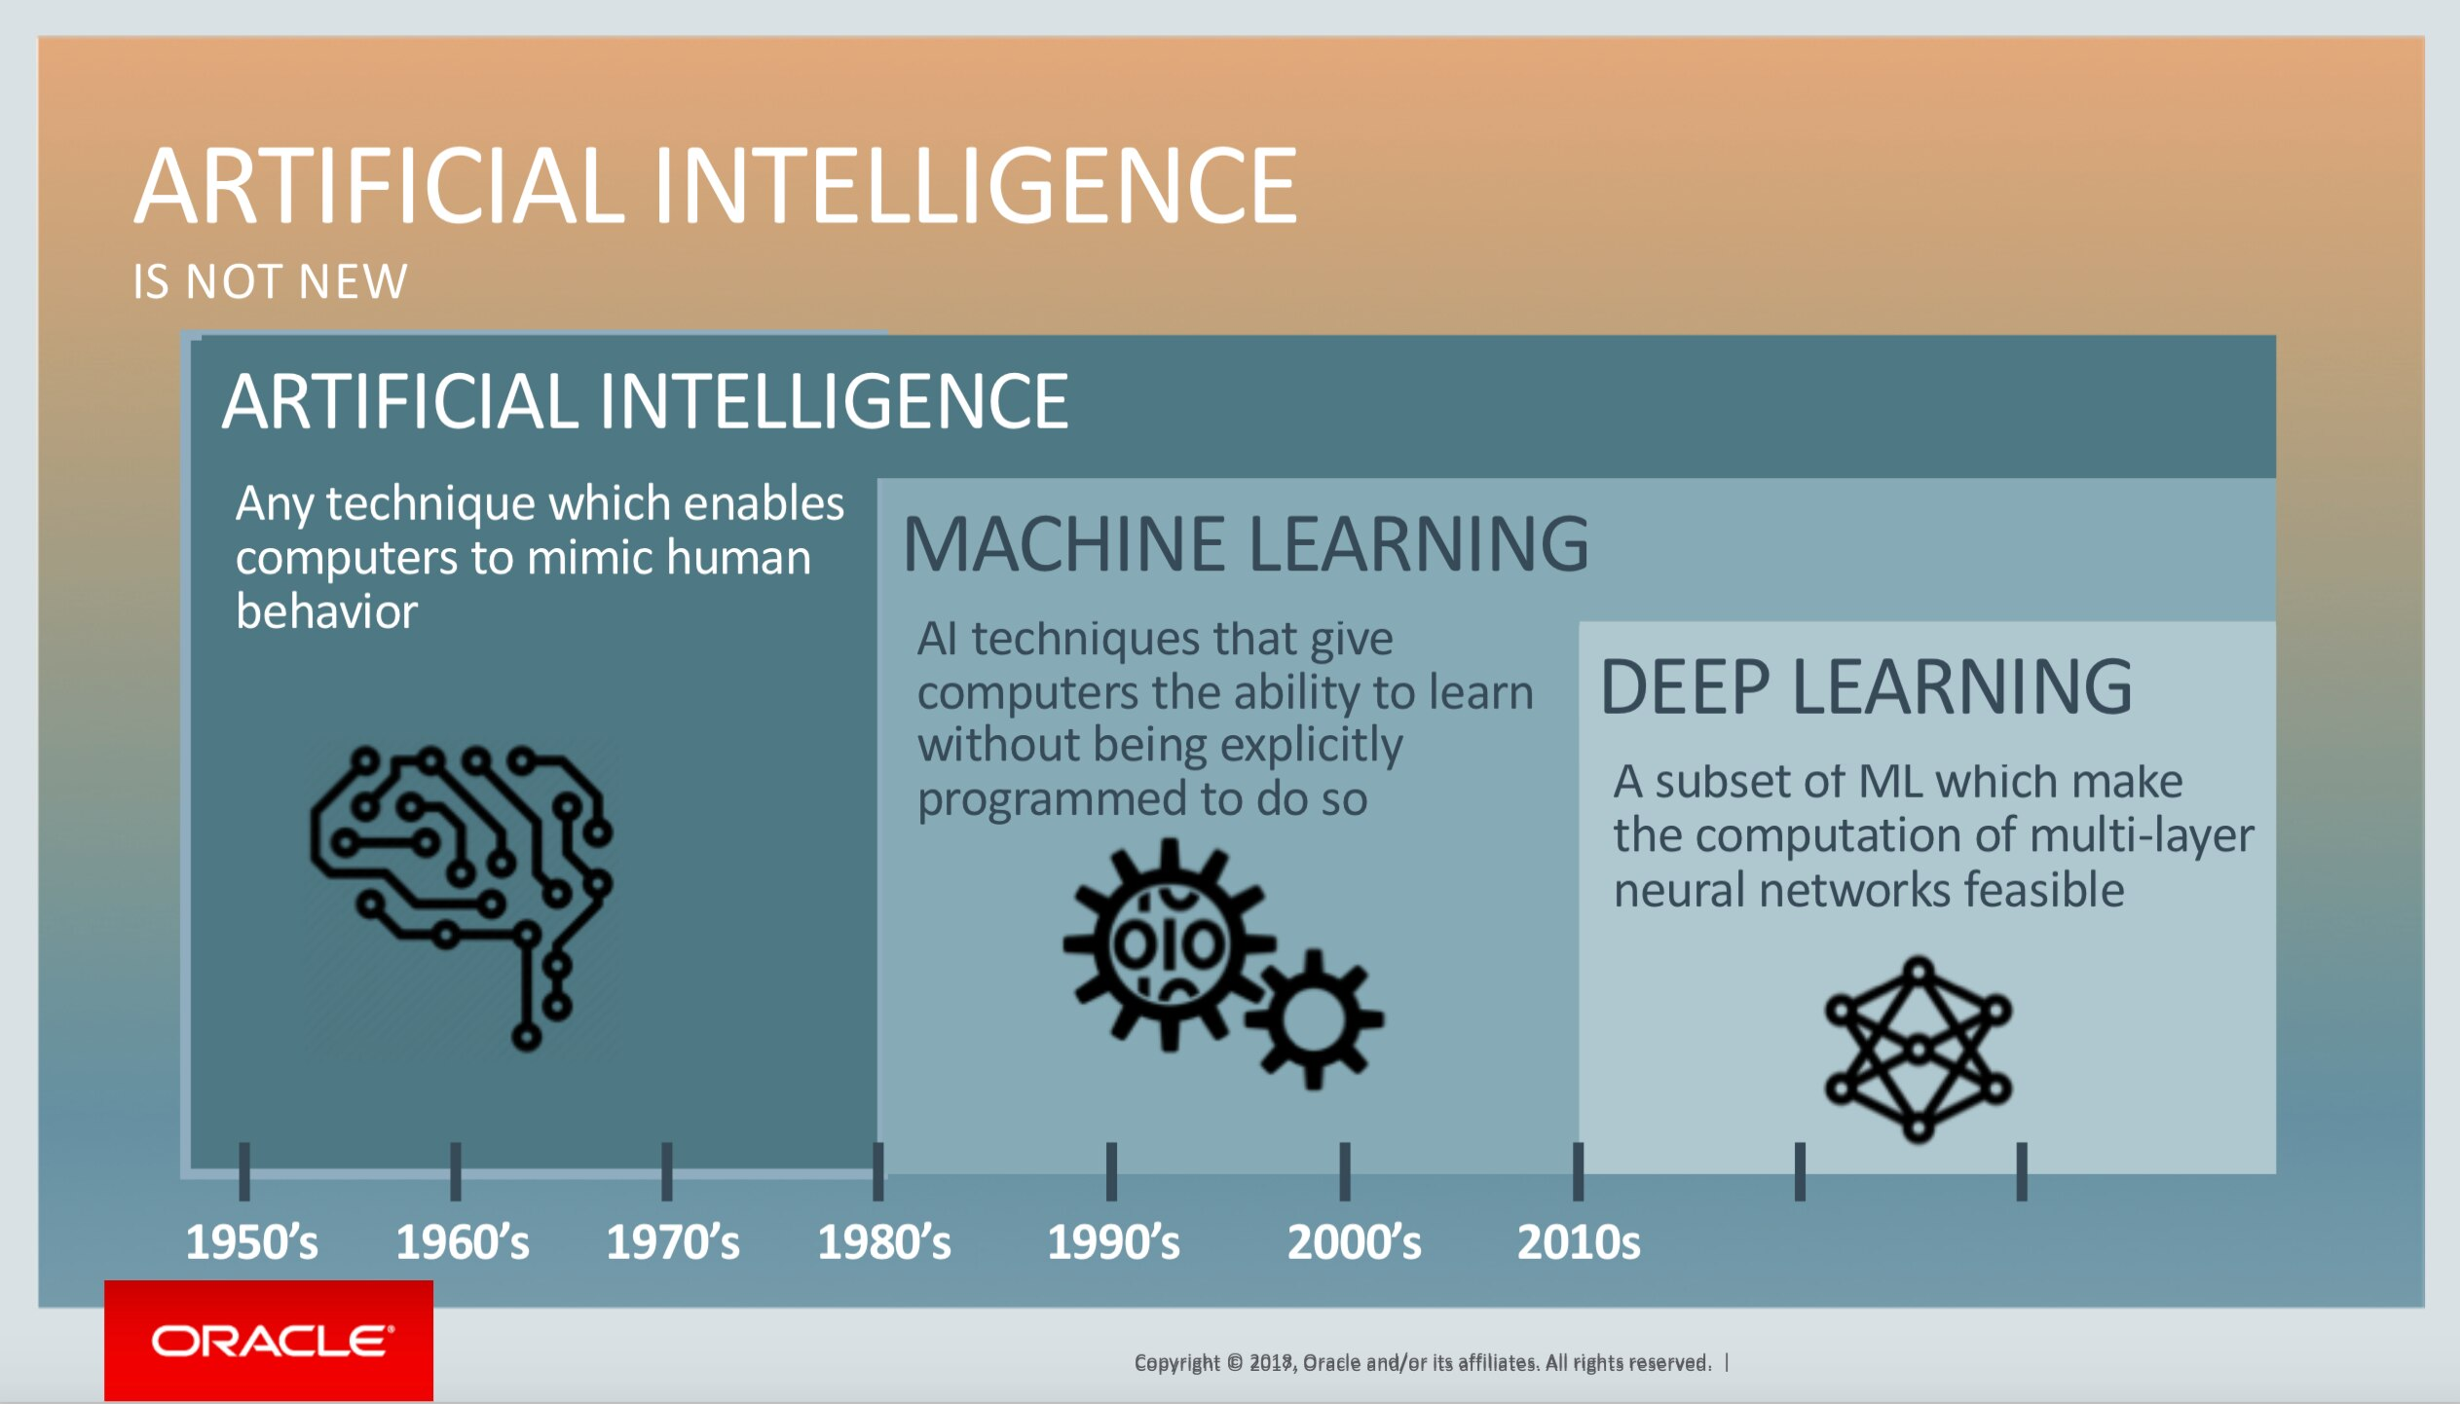
AI related advanced analytics accelerate business digitalization, with unparalleled computing power, rich data and advanced algorithm
Hashing power CPU and GPU
Natural language processing (NLP) refers to the branch of computer science—and more specifically, the branch of artificial intelligence or AI—concerned with giving computers the ability to understand text and spoken words in much the same way human beings can.
Nature Language Processing
Notes:
NLP 包含什么？
天猫精灵，小爱小爱

Slide 31
Adverse event monitoring# @Commerical #
External
Project background
Technical solution
What is adverse event reports?
Automating call centers
Automate information capture
Transfer voice to text
Provide quick analysis
extract relevant medical information
flag adverse events for human experts’ follow-up
Pharma companies need to monitor for adverse events to ensure patient safety and to remain in compliance with regulatory requirements, both in clinical trials and after a drug goes on the market.
Pain point?
Manual, human-centered systems cannot satisfy the rapid increase in adverse event report volume.
Users submitted 2.2 million reports to the FDA in 2019, up from less than 500,000 reports in 2009.
More emerging channels should be monitored besides traditional reporting channels.
Social media, telemedicine visits, and medical chatbots
Widen channels
Including medical records, handwritten physician notes, and social media posts a
Further: evaluate the risk and completeness of the model generated report
Business value
Time saving and cost saving
one case processing: from up to two hours to seconds
Let people focusing on non-labor work
Resource: https://pages.awscloud.com/rs/112-TZM-766/images/FierceBiotech_AWS_Adverse_Events_Whitepaper_Final.pdf

